Slide 1



Project Management Principles and Practices
Spring 2025
Lecturer
Sajid Mehmood

Slide 2
LECTURE OUTLINE
What is Quality.
Overview of Project Quality Management Process.
Importance of Quality in Projects.
Perception about Quality.
Cost & Benefits of Quality.
Changing Views on Quality.
Quality Assurance vs. Control.
7 Tools Of Quality

Slide 3
Quality
What is Quality?
Customers know it when they see it. Suppliers promise that their goods and services embody it.
Why a project manager should be worried about quality?
A customer may demand quality and an organization may promise to deliver quality, but a project manager is the one who has to do it.
Failure can have devastating immediate and long-term consequences for both the project manager and the project organization.
Why quality management is a big issue for projects?
Quality tools and techniques that have been developed and refined over the past 100 years are now a matter of science, not art.
However, their application to projects cannot be takes as a matter of simple transference.
This is because projects come in many stripes and colors.
Take example of a project initiated by a national professional association to create a new technical Manual. This project has little relation to the codified quality tools of manufacturing, except in the final steps of producing the book itself, and that task is usually contracted to a source outside the project team.
This is because projects continue to be plagued by imprecise quality goals and arcane quality methods most suited for a shop floor, all of this condemning the project to less-than-satisfactory results or worse.

Slide 4
Definition of Quality
The key to project quality lies in making a more effective, meaningful transfer of proven quality
methods to a general project management domain.
The first step is to answer the question “What is quality?”
Exercise 1
Answer the following questions on a piece of paper.
Q 1: Meaning of Quality
What does quality mean to you?
What does quality mean to your organization?
Are there any differences you can see? What are they? Q 2: Description of Quality
How do you describe quality to others?
How do you organization describe quality to you?
Are there any differences you can see? What are they? Q 3: Knowing Quality
How do you know quality when you see it? Q 4: Quality Components
What are quality’s component elements?

Slide 5
Definition of Quality
The results of this brief exercise probably vary among individuals. Some central themes may be common to all.
Products
In some way, quality is associated with products.
We may define quality by our view of the features or attributes of some particular product (e.g. an automobile).
This view can lead us to “I’ll know it when I see it” definition of quality.
Defects
The perception of product quality may arise from favorable features, such as an automobile that always starts on the first attempt.
We expect quality products to be free of defects.
When we purchase a car, all the indicator lights on the dashboard should function properly.
Processes
If we manufacture a product, we probably care very much about processes.
Customers focus on product and how it performs. In contrast, our focus is on how it was produced.
For project managers, how the product was produced is very important.
Whether they are delivering a product that results from manufacturing or purely intellectual activity, the processes that produce that product have great effect on the outcome.
What you do may satisfy the customer, but how you do it will keep you on schedule and on budget — and that may result in long-term sustainable relationship between the project manager and customer.

Slide 6
Definition of Quality
Customers
You can build the best products available in the market but these are worthless if nobody is interested in buying these products.
This view of quality may have short-term utility, but can be limiting, even lethal, for the organization in the long term.
The key here is to build relevant products that other people want to buy.
People may have a different view of quality and it is rooted in what customers want.
To these people, quality is defined by customers, their needs, and their expectations.
Systems
A system is a group of things that work together.
At a higher level of analysis, quality may be viewed as arising from things that work together.
Products, defects, processes, and customers are all part of a system that generates quality, as are suppliers, policies, organizations, and perhaps some other things unique to a specific situation.

Slide 7
Definition of Quality
PMI Definition: The PMI defines quality as “the totality of characteristics of an entity that bear on its ability to satisfy stated or implied needs” or “the degree to which a set of inherent characteristics fulfill requirements.”
Project quality management is all the processes and activities needed to determine
and achieve project quality.
Quality is not a naturally occurring event.
It is a result of hard, deliberate work that begins with planning, includes consideration of contributing elements, applies disciplined processes and tools, and never, ever ends.
Achieving quality in project implementation is not a matter of luck or coincidence;
it is a matter of management.

Slide 8
Quality vs. Grade
The project management team must be careful not to confuse quality with grade.
Grade is “a category or rank given to entities having the same functional use but different requirements for quality” [3]. Low quality is always a problem; low grade may not be.
For example, a software product may be of high quality (no obvious bugs, readable manual) and low grade (a limited number of features), or of low quality (many bugs, poorly organized user documentation) and high grade (numerous features).
Determining and delivering the required levels of both quality and grade are the responsibilities of the project manager and the project management team.

Slide 9
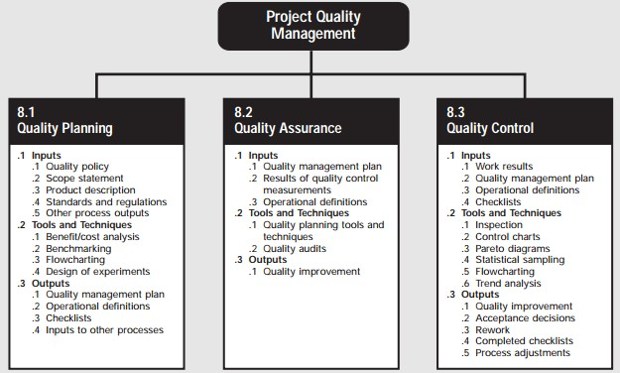
Project Quality Management Process

Slide 10
Project Quality Management Process
Plan Quality Management—The process of identifying quality requirements and/or standards for the project and its deliverables and documenting how the project will demonstrate compliance with quality requirements.
Perform Quality Assurance—The process of auditing the quality requirements and the results from quality control measurements to ensure that appropriate quality standards and operational definitions are used.
Control Quality—The process of monitoring and recording results of executing the quality activities to assess performance and recommend necessary changes.

Slide 11
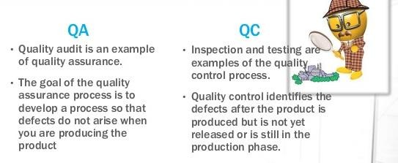
Quality Assurance vs. Quality Control

Slide 12
Cost of Quality
Cost Of Quality
According to ASQ: The "cost of quality" isn't the price of creating a quality product or service. It's the cost of NOT creating a quality product or service.
Every time work is redone, the cost of quality increases. Obvious examples include:
  The reworking of a manufactured item.
  The retesting of an assembly.
  The rebuilding of a tool.
  The reworking of a service, such as the reprocessing of a loan operation or the replacement of a food order in a restaurant.
In short, any cost that would not have been expended if quality were perfect contributes to
the cost of quality.

Slide 13
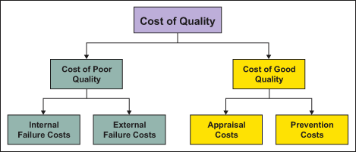
Cost of Quality
Appraisal Costs include all activities associated with assuring a product or service conforms to performance requirements and standards.
Prevention Costs include all activities intended to prevent poor quality in products or services.
Failure Costs:
Internal include all activities associated with a product or service not meeting standards or customer requirements prior to delivery to the customer.
External include all activities associated with a product or service not meeting standards or customer requirements at or after delivery to the customer.

Slide 14
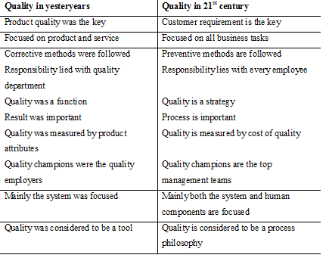
Changing Views on Quality

Slide 15
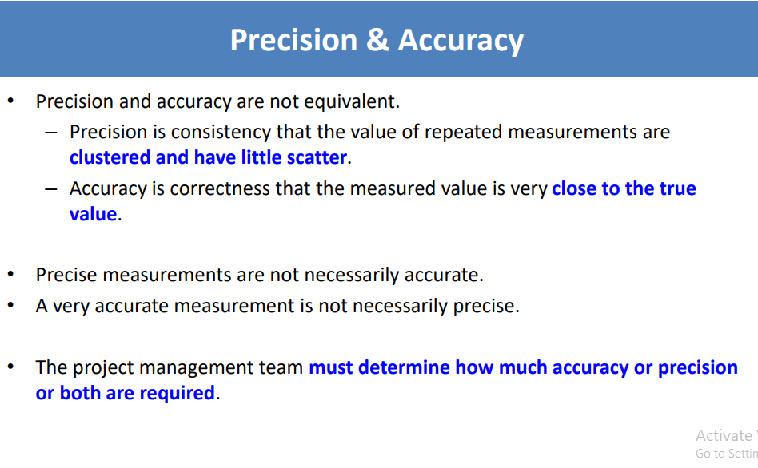
PRECISION & ACCURACY

Slide 16
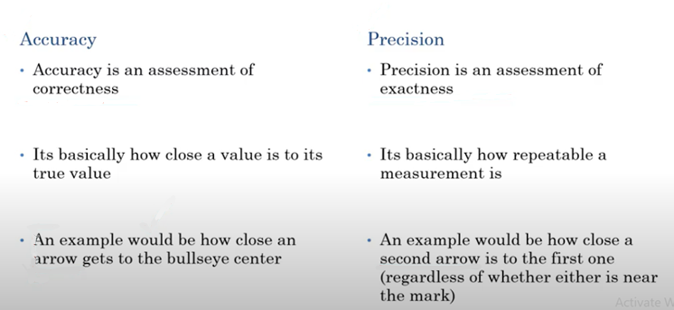
ACCURACY VS PRECISION

Slide 17
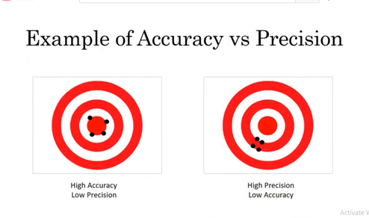

Slide 18
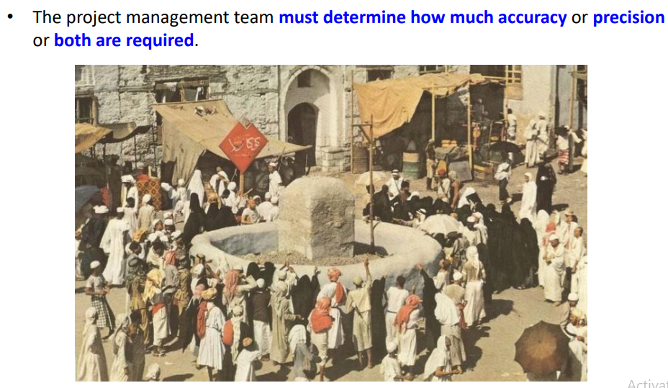
ACCURACY & PRECISION

Slide 19
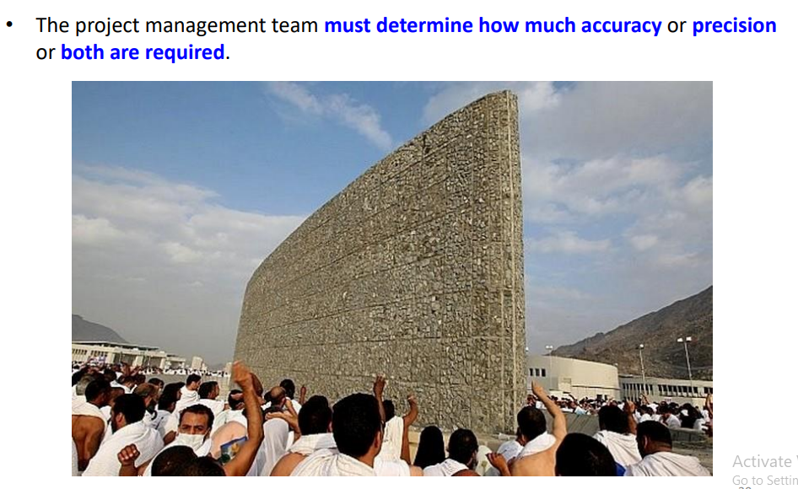

Slide 20
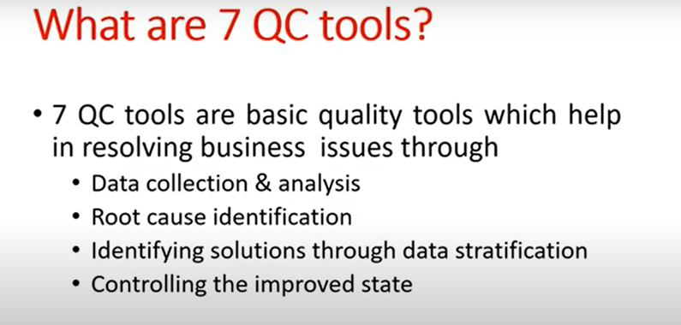
7 QC TOOLS
The 7 QC tools are fundamental instruments to improve the process and product quality. They are used to examine the production process, identify the key issues, control fluctuations of product quality, and give solutions to avoid future defect

Slide 21
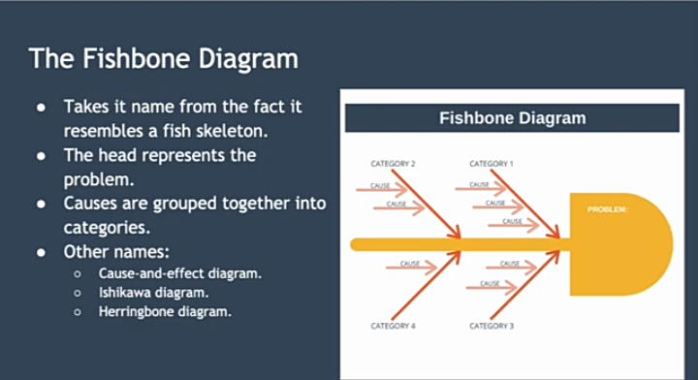
FISH BONE DIAGRAM

Slide 22
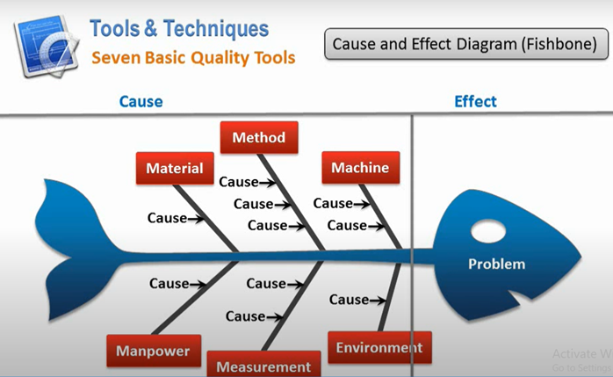

Slide 23
1. Man (People)
Refers to: Human involvement, skills, training, behavior.
How to measure:
Error rate or number of defects caused by human error
Training hours per employee
Skill competency assessments
Employee satisfaction or engagement surveys
Adherence to standard procedures
✅ 2. Machine
Refers to: Equipment, tools, and technology used in the process.
How to measure:
Equipment downtime or failure rate
Maintenance frequency and records
Calibration status and accuracy
Output efficiency or machine utilization rate
Age and condition of machinery
✅ 3. Method
Refers to: The processes or procedures used to complete tasks.
How to measure:
Process cycle time
Number of process steps or handoffs
Standard Operating Procedure (SOP) compliance rate
Variation in methods among different teams/shifts
Process audit results
✅ 4. Material
Refers to: Raw materials, components, or consumables used in production.
How to measure:
Defect rate in incoming materials
Supplier quality ratings
Material wastage or scrap rate
Consistency in material specifications
Inventory accuracy

Slide 24
✅ 5. Measurement
Refers to: Data collection methods, instruments, and accuracy.
How to measure:
Calibration frequency of measurement tools
Measurement error rate
Consistency and reliability of data
Use of control charts to assess variation
Inspection pass/fail ratios
✅ 6. Mother Nature (Environment)
Refers to: Surroundings including temperature, humidity, lighting, cleanliness, etc.
How to measure:
Environmental monitoring data (e.g., temperature, humidity)
Cleanroom or workspace contamination levels
Noise or lighting level audits
Compliance with safety/environmental standards
Impact of weather or seasonal changes on process

Slide 25
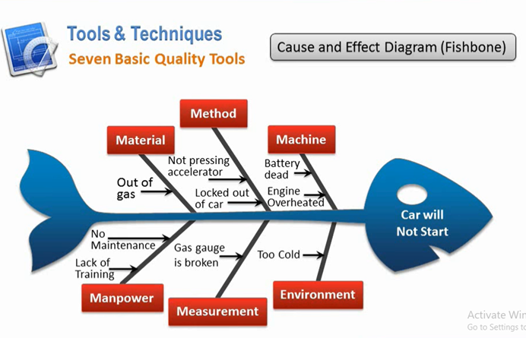

Slide 26
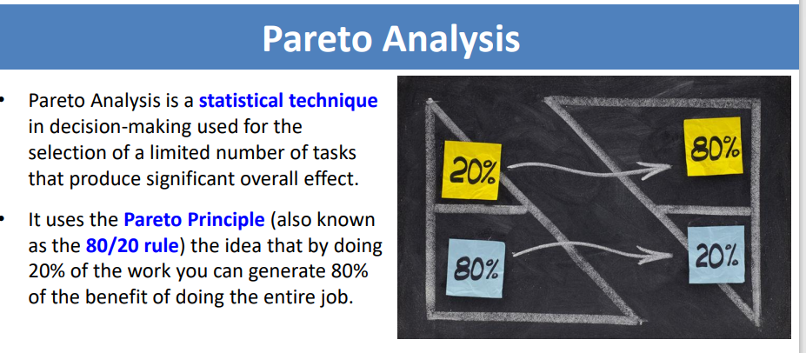
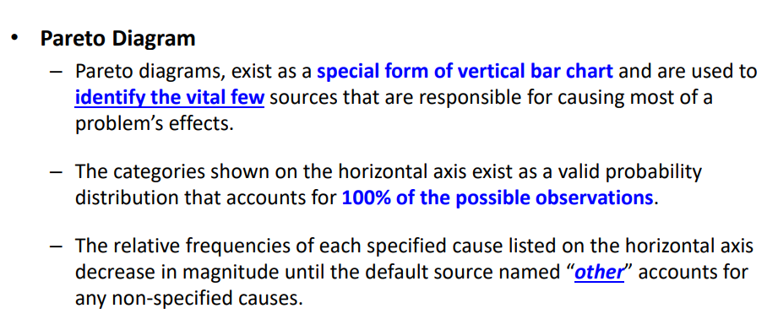

Slide 27
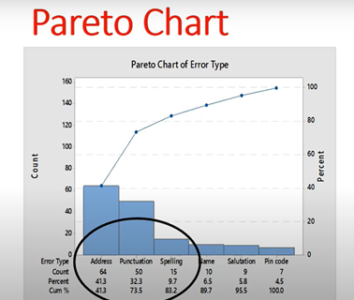
EXAMPLE

Slide 28
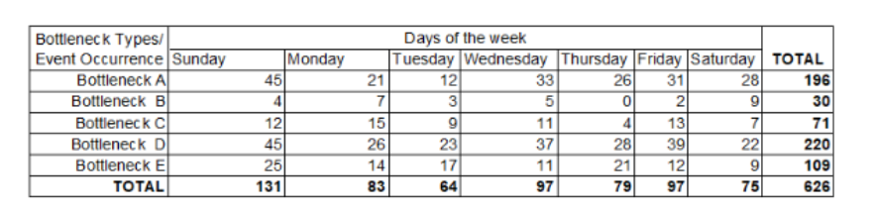
EXERCISE

Slide 29
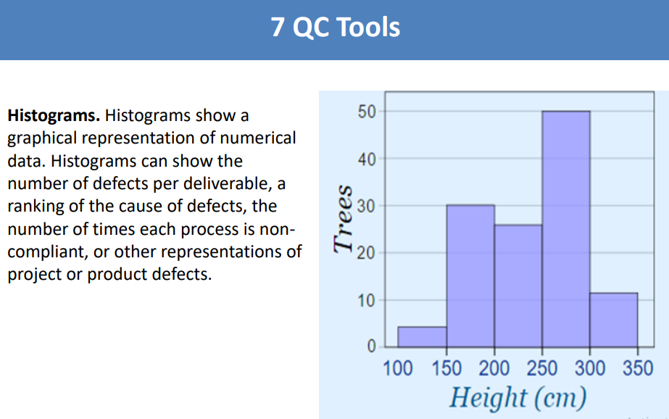
HISTOGRAM

Slide 30
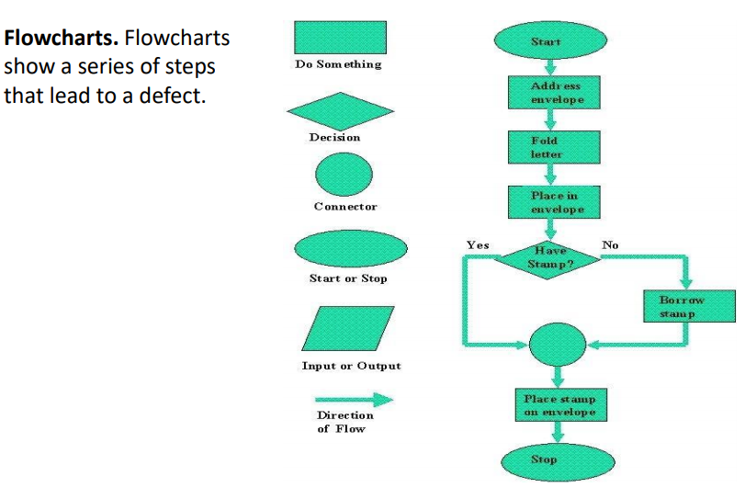
FLOW CHART
A flow chart is a visual representation of a process

Slide 31
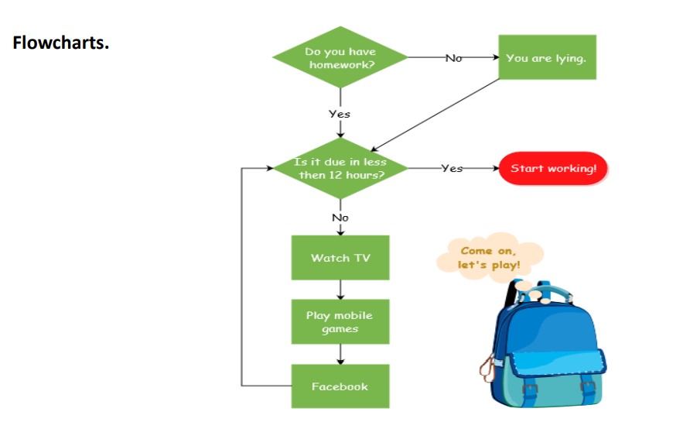
FLOW CHART

Slide 32
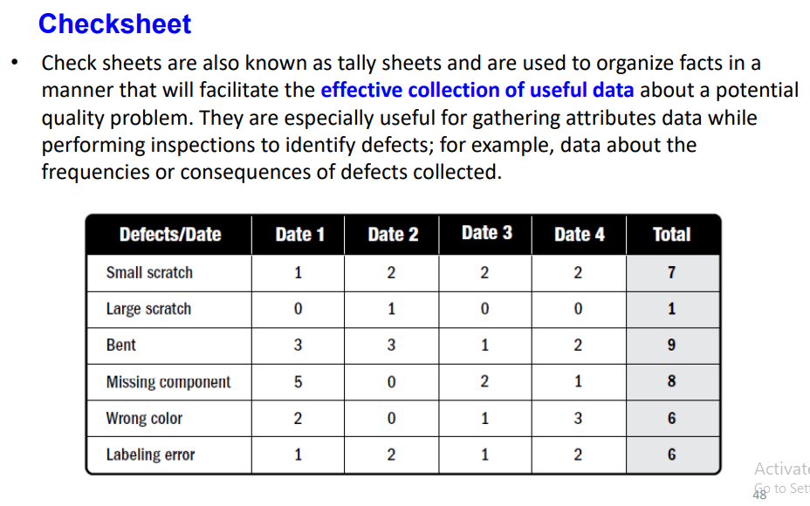
CHECKSHEET

Slide 33
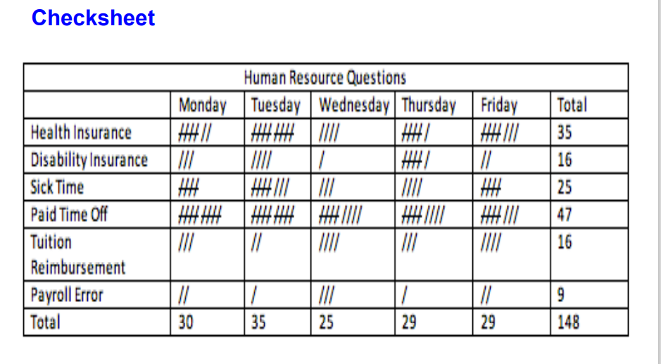
The purpose of a checklist is to summarize, and in some cases; graphically depict a tally count of event occurrences.

Slide 34
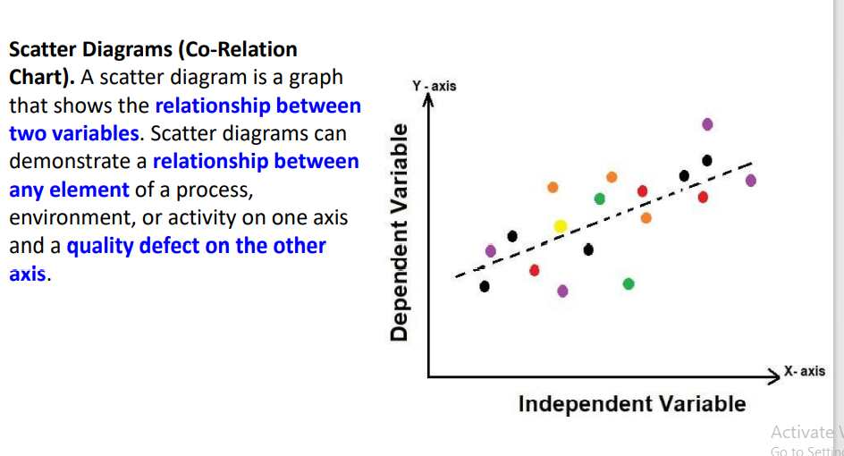
SCATTER DIAGRAM

Slide 35
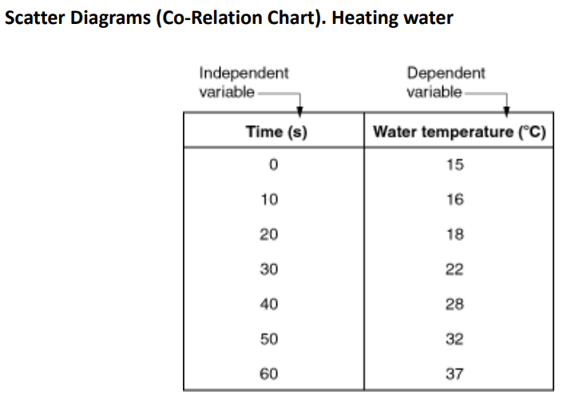

Slide 36
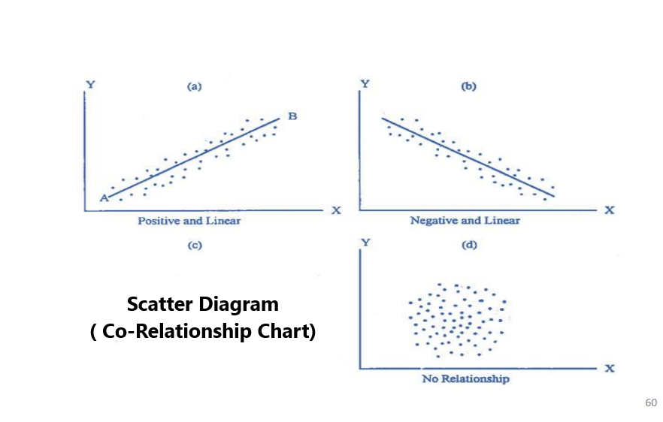
SCATTER DIAGRAM

Slide 37
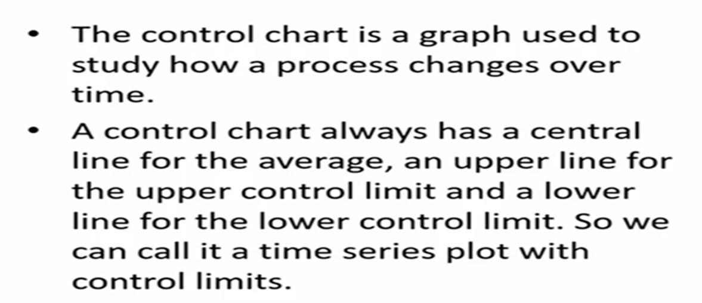
CONTROL CHART
The best tool to investigate variation in a process is a control chart. A control chart is often called a time series plot that is used to monitor a process over time

Slide 38
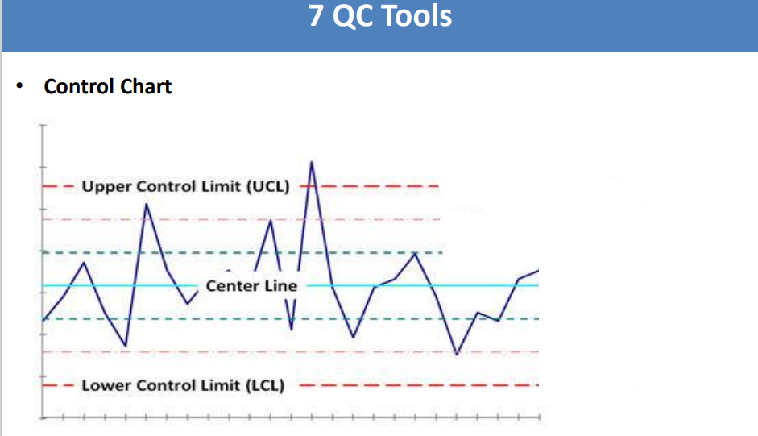
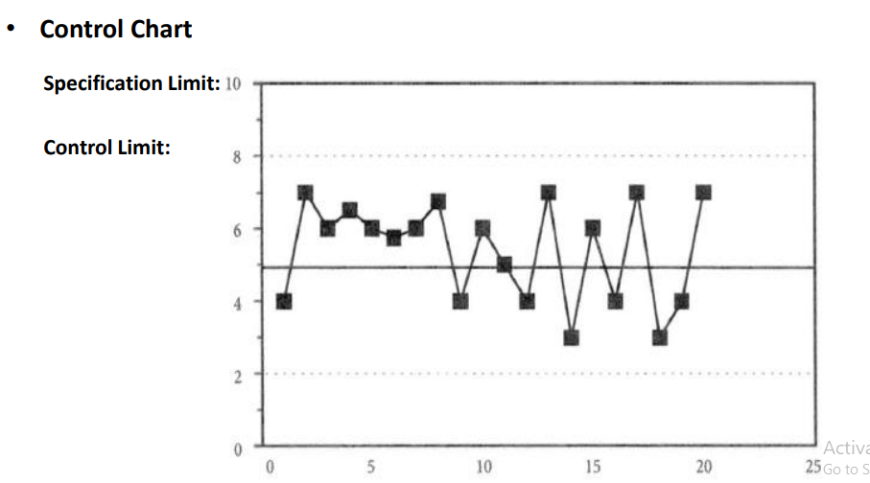
CONTROL CHART

Slide 39
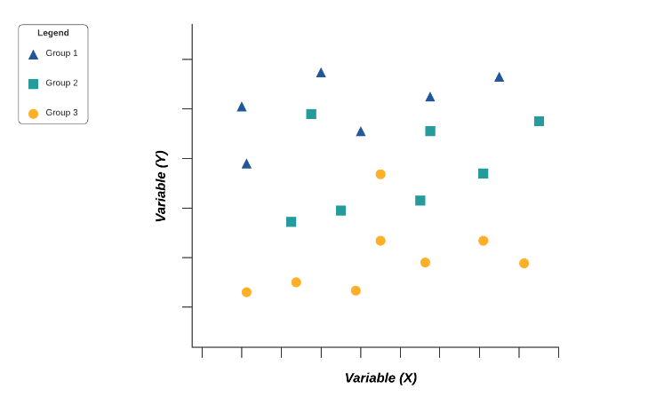
Stratification
Stratification analysis is a quality assurance tool used to sort data, objects, and people into separate and distinct groups. Separating your data using stratification can help you determine its meaning, revealing patterns that might not otherwise be visible when it’s been lumped together.
Whether you’re looking at equipment, products, shifts, materials, or even days of the week, stratification analysis lets you make sense of your data before, during, and after its collection.

